Slide 2
C++ в 2018
Успехи года
Полухин Антон
Antony Polukhin

Slide 3
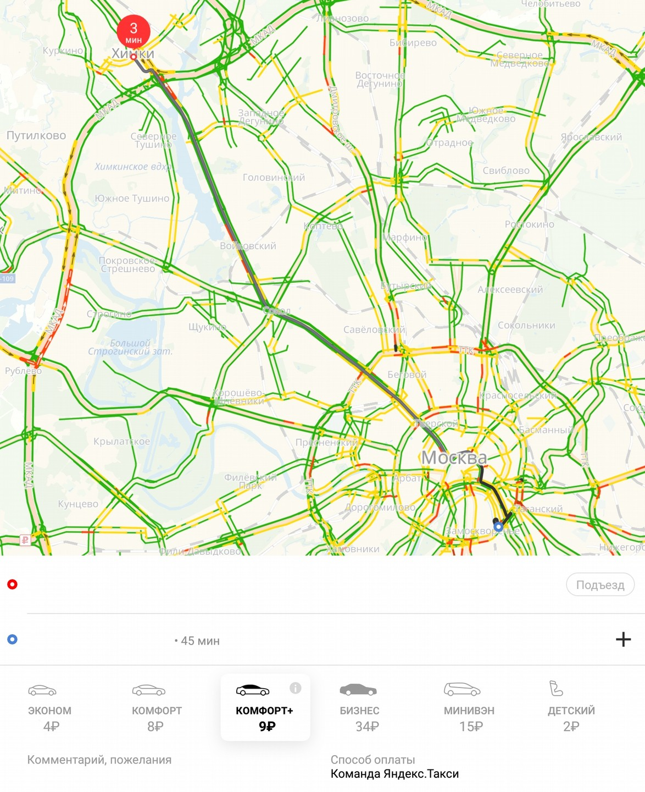
Содержание
C++ 2k18
C++ 2k19
Concepts
Contracts
Ranges
Modules
РГ 21
C++ в 2018

Slide 4
Concepts
C++ в 2018

Slide 5
Concepts
template <class T>
void insert_100_elements(T& container) {
// container.reserve(container.size() + 100);
assert(!container.empty());
auto v = container.back();
for (unsigned i = 0; i < 100; ++i) {
container.insert(container.end(), v + i);
}
}
C++ в 2018
<number> / 63

Slide 6
Concepts
template <Container T>
void insert_100_elements(T& container) {
// container.reserve(container.size() + 100);
assert(!container.empty());
auto v = container.back();
for (unsigned i = 0; i < 100; ++i) {
container.insert(container.end(), v + i);
}
}
C++ в 2018
<number> / 63

Slide 7
Concepts
void insert_100_elements(Container auto& container) {
// container.reserve(container.size() + 100);
assert(!container.empty());
auto v = container.back();
for (unsigned i = 0; i < 100; ++i) {
container.insert(container.end(), v + i);
}
}
C++ в 2018
<number> / 63

Slide 8
Concepts
template <class T>
void insert_100_elements(T& container) {
// container.reserve(container.size() + 100);
assert(!container.empty());
auto v = container.back();
for (unsigned i = 0; i < 100; ++i) {
container.insert(container.end(), v + i);
}
}
C++ в 2018
<number> / 63

Slide 9
Concepts
template <class T>
void insert_100_elements(T& container) {
// container.reserve(container.size() + 100);
assert(!container.empty());
auto v = container.back();
for (unsigned i = 0; i < 100; ++i) {
container.insert(container.end(), v + i);
}
}
C++ в 2018
<number> / 63

Slide 10
Concepts
template <class T>
void insert_100_elements(T& container) {
if constexpr (requires{ container.reserve(container.size() + 100); }) {
container.reserve(container.size() + 100);
}
assert(!container.empty());
auto v = container.back();
for (unsigned i = 0; i < 100; ++i) {
container.insert(container.end(), v + i);
}
}
C++ в 2018
<number> / 63

Slide 11
Contracts
C++ в 2018

Slide 12
Contracts
template <class T>
void insert_100_elements(T& container) {
if constexpr (requires{ container.reserve(container.size() + 100); }) {
container.reserve(container.size() + 100);
}
assert(!container.empty());
auto v = container.back();
for (unsigned i = 0; i < 100; ++i) {
container.insert(container.end(), v + i);
}
}
C++ в 2018
<number> / 63

Slide 13
Contracts
template <class T>
void insert_100_elements(T& container) {
if constexpr (requires{ container.reserve(container.size() + 100); }) {
container.reserve(container.size() + 100);
}
assert(!container.empty());
auto v = container.back();
for (unsigned i = 0; i < 100; ++i) {
container.insert(container.end(), v + i);
}
}
C++ в 2018
<number> / 63

Slide 14
Contracts
template <class T> void insert_100_elements(T& container)
[[expects: !container.empty()]]
[[ensures axiom: container.size() > 100]]
{
if constexpr (requires{ container.reserve(container.size() + 100); }) {
container.reserve(container.size() + 100);
}
auto v = container.back();
for (unsigned i = 0; i < 100; ++i) {
container.insert(container.end(), v + i);
}
}
C++ в 2018
<number> / 63

Slide 15
Ranges
C++ в 2018

Slide 16
Введение в Ranges
// <algorithm>
namespace std {
template <class InputIterator, class T>
constexpr InputIterator find(InputIterator first, InputIterator last,
const T& value);
} // namespace std
C++ в 2018
<number> / 63

Slide 17
Введение в Ranges
// <algorithm>
namespace std::ranges {
template <InputIterator I, Sentinel<I> S, class T, class Proj = identity>
requires IndirectRelation<ranges::equal_to<>, projected<I, Proj>, const T*>
constexpr I find(I first, S last, const T& value, Proj proj = {});
template <InputRange R, class T, class Proj = identity>
requires IndirectRelation<ranges::equal_to<>, projected<iterator_t<R>, Proj>, const T*>
constexpr safe_iterator_t<R> find(R&& r, const T& value, Proj proj = {});
} // namespace std::ranges
C++ в 2018
<number> / 63

Slide 18
Введение в Ranges
// <algorithm>
namespace std::ranges {
template <InputIterator I, Sentinel<I> S, class T, class Proj = identity>
requires IndirectRelation<ranges::equal_to<>, projected<I, Proj>, const T*>
constexpr I find(I first, S last, const T& value, Proj proj = {});
template <InputRange R, class T, class Proj = identity>
requires IndirectRelation<ranges::equal_to<>, projected<iterator_t<R>, Proj>, const T*>
constexpr safe_iterator_t<R> find(R&& r, const T& value, Proj proj = {});
} // namespace std::ranges
C++ в 2018
<number> / 63

Slide 19
Введение в Ranges
// <algorithm>
namespace std::ranges {
template <InputIterator I, Sentinel<I> S, class T, class Proj = identity>
requires IndirectRelation<ranges::equal_to<>, projected<I, Proj>, const T*>
constexpr I find(I first, S last, const T& value, Proj proj = {});
} // namespace std::ranges
C++ в 2018
<number> / 63

Slide 20
Введение в Ranges
// <algorithm>
namespace std::ranges {
template <InputIterator I, Sentinel<I> S, class T, class Proj = identity>
requires IndirectRelation<ranges::equal_to<>, projected<I, Proj>, const T*>
constexpr I find(I first, S last, const T& value, Proj proj = {});
} // namespace std::ranges
C++ в 2018
<number> / 63

Slide 21
Введение в Ranges
// <algorithm>
namespace std::ranges {
template <InputIterator I, Sentinel<I> S, class T, class Proj = identity>
requires IndirectRelation<ranges::equal_to<>, projected<I, Proj>, const T*>
constexpr I find(I first, S last, const T& value, Proj proj = {});
} // namespace std::ranges
const char* char_ptr = "....";
auto it = std::ranges::find(char_ptr, std::unreachable_sentinel, '.');
C++ в 2018
<number> / 63

Slide 22
Введение в Ranges
// <algorithm>
namespace std::ranges {
template <InputIterator I, Sentinel<I> S, class T, class Proj = identity>
requires IndirectRelation<ranges::equal_to<>, projected<I, Proj>, const T*>
constexpr I find(I first, S last, const T& value, Proj proj = {});
} // namespace std::ranges
const char* char_ptr = "....";
auto it = std::ranges::find(char_ptr, value_sentinel{'\0'}, '.');
C++ в 2018
<number> / 63

Slide 23
Введение в Ranges
// <algorithm>
namespace std::ranges {
template <InputIterator I, Sentinel<I> S, class T, class Proj = identity>
requires IndirectRelation<ranges::equal_to<>, projected<I, Proj>, const T*>
constexpr I find(I first, S last, const T& value, Proj proj = {});
} // namespace std::ranges
C++ в 2018
<number> / 63

Slide 24
Введение в Ranges
// <algorithm>
namespace std::ranges {
template <InputIterator I, Sentinel<I> S, class T, class Proj = identity>
requires IndirectRelation<ranges::equal_to<>, projected<I, Proj>, const T*>
constexpr I find(I first, S last, const T& value, Proj proj = {});
} // namespace std::ranges
C++ в 2018
<number> / 63

Slide 25
Введение в Ranges
// <algorithm>
namespace std::ranges {
template <InputIterator I, Sentinel<I> S, class T, class Proj = identity>
requires IndirectRelation<ranges::equal_to<>, projected<I, Proj>, const T*>
constexpr I find(I first, S last, const T& value, Proj proj = {});
} // namespace std::ranges
C++ в 2018
<number> / 63

Slide 26
Введение в Ranges
// <algorithm>
namespace std::ranges {
template <InputIterator I, Sentinel<I> S, class T, class Proj = identity>
requires IndirectRelation<ranges::equal_to<>, projected<I, Proj>, const T*>
constexpr I find(I first, S last, const T& value, Proj proj = {});
} // namespace std::ranges
std::unordered_map<int, std::string> map = {....};
auto it = std::ranges::find(map.cbegin(), map.cend(), "Hello"sv,
[](const auto& v) -> std::string_view { return v.second; });
C++ в 2018
<number> / 63

Slide 27
Введение в Ranges
// <algorithm>
namespace std::ranges {
template <InputIterator I, Sentinel<I> S, class T, class Proj = identity>
requires IndirectRelation<ranges::equal_to<>, projected<I, Proj>, const T*>
constexpr I find(I first, S last, const T& value, Proj proj = {});
template <InputRange R, class T, class Proj = identity>
requires IndirectRelation<ranges::equal_to<>, projected<iterator_t<R>, Proj>, const T*>
constexpr safe_iterator_t<R> find(R&& r, const T& value, Proj proj = {});
} // namespace std::ranges
C++ в 2018
<number> / 63

Slide 28
Введение в Ranges
// <algorithm>
namespace std::ranges {
template <InputIterator I, Sentinel<I> S, class T, class Proj = identity>
requires IndirectRelation<ranges::equal_to<>, projected<I, Proj>, const T*>
constexpr I find(I first, S last, const T& value, Proj proj = {});
template <InputRange R, class T, class Proj = identity>
requires IndirectRelation<ranges::equal_to<>, projected<iterator_t<R>, Proj>, const T*>
constexpr safe_iterator_t<R> find(R&& r, const T& value, Proj proj = {});
} // namespace std::ranges
C++ в 2018
<number> / 63

Slide 29
Введение в Ranges
// <algorithm>
namespace std::ranges {
template <InputRange R, class T, class Proj = identity>
requires IndirectRelation<ranges::equal_to<>, projected<iterator_t<R>, Proj>, const T*>
constexpr safe_iterator_t<R> find(R&& r, const T& value, Proj proj = {});
} // namespace std::ranges
C++ в 2018
<number> / 63

Slide 30
Введение в Ranges
// <algorithm>
namespace std::ranges {
template <InputRange R, class T, class Proj = identity>
requires IndirectRelation<ranges::equal_to<>, projected<iterator_t<R>, Proj>, const T*>
constexpr safe_iterator_t<R> find(R&& r, const T& value, Proj proj = {});
} // namespace std::ranges
C++ в 2018
<number> / 63

Slide 31
Введение в Ranges
// <algorithm>
namespace std::ranges {
template <InputRange R, class T, class Proj = identity>
requires IndirectRelation<ranges::equal_to<>, projected<iterator_t<R>, Proj>, const T*>
constexpr safe_iterator_t<R> find(R&& r, const T& value, Proj proj = {});
} // namespace std::ranges
const char data[] = "....";
auto it = std::ranges::find(data, '.');
C++ в 2018
<number> / 63

Slide 32
Введение в Ranges
// <algorithm>
namespace std::ranges {
template <InputRange R, class T, class Proj = identity>
requires IndirectRelation<ranges::equal_to<>, projected<iterator_t<R>, Proj>, const T*>
constexpr safe_iterator_t<R> find(R&& r, const T& value, Proj proj = {});
} // namespace std::ranges
std::unordered_map<int, std::string> map = {....};
auto it = std::ranges::find(map, "Hello"sv,
[](const auto& v) -> std::string_view { return v.second; });
C++ в 2018
<number> / 63

Slide 33
Ranges
Часть 2
C++ в 2018

Slide 34
Views
// <ranges>
namespace std::view {
inline constexpr unspecified transform = unspecified;
inline constexpr unspecified filter = unspecified;
inline constexpr unspecified join = unspecified;
inline constexpr unspecified split = unspecified;
inline constexpr unspecified iota = unspecified;
inline constexpr unspecified reverse = unspecified;
inline constexpr unspecified counted = unspecified;
} // namespace std::view
C++ в 2018
<number> / 63

Slide 35
Views
#include <ranges>
std::string str = "abcd";
C++ в 2018
<number> / 63

Slide 36
Views
#include <ranges>
std::string str = "abcd";
for (auto c : std::view::reverse(str)) {
std::cout << c;
}
C++ в 2018
<number> / 63

Slide 37
Views
#include <ranges>
std::string str = "abcd";
for (auto c : std::view::reverse(str)) {
std::cout << c;
}
std::ranges::copy(std::view::reverse(str), std::ostream_iterator<char>(std::cout));
C++ в 2018
<number> / 63

Slide 38
Views
#include <ranges>
std::string_view str = "Ranges! Are! Awesome!";
for (auto word : std::view::split(str, ' ')) {
std::ranges::copy(word, std::ostream_iterator<char>(std::cout));
std::cout << '\n';
}
C++ в 2018
<number> / 63

Slide 39
Views
#include <ranges>
std::string_view str = "Ranges! Are! Awesome!";
for (auto word : std::view::split(str, ' ')) {
std::ranges::copy(word, std::ostream_iterator<char>(std::cout));
std::cout << '\n';
}
// "Ranges!\nAre!\nAwesome!\n"
C++ в 2018
<number> / 63

Slide 40
Views
#include <ranges>
std::string_view str = "Ranges! Are! Awesome!";
for (auto word : str | std::view::split(' ')) {
std::ranges::copy(word, std::ostream_iterator<char>(std::cout));
std::cout << '\n';
}
C++ в 2018
<number> / 63

Slide 41
Views
#include <ranges>
std::string_view str = "Ranges! Are! Awesome!";
for (auto word : str | std::view::split(' ')) {
std::ranges::copy(word, std::ostream_iterator<char>(std::cout));
std::cout << '\n';
}
// "Ranges!\nAre!\nAwesome!\n"
C++ в 2018
<number> / 63

Slide 42
Views
#include <ranges>
std::string_view str = "Ranges! Are! Awesome!";
constexpr auto f = [](char c) { return c != '!'; };
for (auto word : str | std::view::filter(f) | std::view::split(' ')) {
std::ranges::copy(word, std::ostream_iterator<char>(std::cout));
std::cout << '\n';
}
// "Ranges\nAre\nAwesome\n"
C++ в 2018
<number> / 63

Slide 43
Views
#include <ranges>
std::string_view str = "Ranges! Are! Awesome!";
constexpr auto f = [](char c) { return c != '!'; };
constexpr auto t = [](char c) { return std::tolower(c); };
using namespace v = std::view;
for (auto word : str | v::filter(f) | v::transform(t) | v::split(' ')) {
std::ranges::copy(word, std::ostream_iterator<char>(std::cout));
std::cout << '|';
}
// "ranges|are|awesome|"
C++ в 2018
<number> / 63

Slide 44
Views
#include <ranges>
#include <algorithm>
#include <cctype>
template <class T> bool is_palindrome(const T& str) {
using namespace v = std::view;
auto f = str | v::filter([](int x) { return std::isalpha(x); })
| v::transform([](auto x) { return std::tolower(x); });
return std::ranges::equal(f, v::reverse(f));
}
assert(is_palindrome("Madam, I'm Adam"));
C++ в 2018
<number> / 63

Slide 45
Modules
C++ в 2018

Slide 46
Modules
C++ в 2018

Slide 47
РГ21
C++ в 2018

Slide 48
РГ21:
* Stacktrace
std::stacktrace s;
std::cout << s;
C++ в 2018
<number> / 63

Slide 49
РГ21:
* Stacktrace
* Constexpr everything
C++ в 2018
<number> / 63

Slide 50
РГ21:
* Stacktrace
* Constexpr everything (P0639R0)
* It is simple to add constexpr all around the container declaration
* ...allowing non trivial destructors in constant expressions
* Exceptions could not be thrown in constant expression so it seems OK to allow try and catch in constant expressions that just do nothing
* Instead of having a magic constexpr_vector that allocates memory, please change it to magic constexpr_allocator that allocates memory in constant expressions.
* Instead of placement new use constructor+move_assignment
C++ в 2018
<number> / 63

Slide 51
РГ21:
* Stacktrace
* Constexpr everything
* algorithms
* iterators
* utility
C++ в 2018
<number> / 63

Slide 52
РГ21:
* Stacktrace
* Constexpr everything
* Realloc
C++ в 2018
<number> / 63

Slide 53
РГ21:
* Stacktrace
* Constexpr everything
* Realloc (презентовали)
bool std::allocator_traits<A>::realloc(...)
C++ в 2018
<number> / 63

Slide 54
РГ21:
* Stacktrace
* Constexpr everything
* Realloc (презентовали)
capacity
free memory
C++ в 2018
<number> / 63

Slide 55
РГ21:
* Stacktrace
* Constexpr everything
* Realloc (презентовали)
template <class T>
using pool_vector
= std::vector<T, pool_allocator<T, N>>;
C++ в 2018
<number> / 63

Slide 56
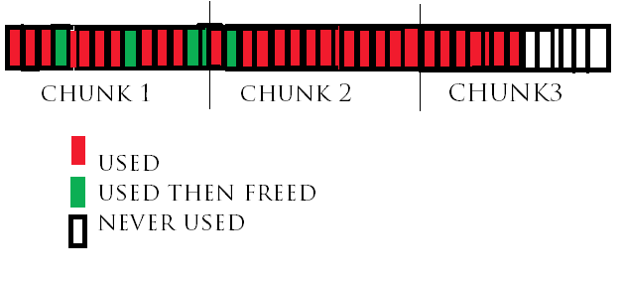
РГ21:
* Stacktrace
* Constexpr everything
* Realloc (презентовали)
template <class T>
using pool_vector
= std::vector<T, pool_allocator<T, N>>;
C++ в 2018
<number> / 63

Slide 57
РГ21:
* Stacktrace
* Constexpr everything
* Realloc (презентовали)
* Concurrent unordered hash map
C++ в 2018
<number> / 63

Slide 58
РГ21:
* Stacktrace
* Constexpr everything
* Realloc (презентовали)
* Concurrent unordered hash map
* Numbers
C++ в 2018
<number> / 63

Slide 59
РГ21:
* Stacktrace
* Constexpr everything
* Realloc (презентовали)
* Concurrent unordered hash map
* Numbers
* [[shared]] (сопереживали)
C++ в 2018
<number> / 63

Slide 60
РГ21:
* Stacktrace
* Constexpr everything
* Realloc (презентовали)
* Concurrent unordered hash map
* Numbers
* [[shared]] (сопереживали)
* Ultimate copy elisions
C++ в 2018
<number> / 63

Slide 61
РГ21:
* Stacktrace
* Constexpr everything
* Realloc (презентовали)
* Concurrent unordered hash map
* Numbers
* [[shared]] (сопереживали)
* Ultimate copy elisions
T produce(); T update(T b); T shrink(T c);
T d = shrink(update(produce()));
C++ в 2018
<number> / 63

Slide 62
Спасибо

Slide 63

Полухин Антон
Старший разработчик Yandex.Taxi
antoshkka@gmail.com
antoshkka@yandex-team.ru
https://github.com/apolukhin
https://stdcpp.ru/

